Slide 1
Developing a DEAL Methodology:
Viewing Detroit through the lenses of racial equity and structural racism
DRAFT v.1
As presented Feb. 4, 2016
Detroiters Speak
Presentation by eliza perez-ollin and Peter J. Hammer
Detroit Equity Action Lab (DEAL)
eliza@wayne.edu and peter.hammer@wayne.edu
For more info on DEAL:
http://law.wayne.edu/keithcenter/detroit-equity-action-lab/index.php

Slide 2
What does it mean to look through the lenses of racial equity and structural racism?

Slide 3
What is racism?

Slide 4
We usually think of:
Racist Beliefs
Intentionally Racist Actions

Slide 5
Where is the DEAL focus?:
Systemic Racism--especially Structural Racism
Lack of racial equity

Slide 6
What is Structural Racism?
Societal Level
Can be intentional
BUT often unintentional
Does NOT require intention to perpetuate
DOES require intention to interrupt
Cultural Messages (convey beliefs)
Practices
Policies
Structural Racism

Slide 7
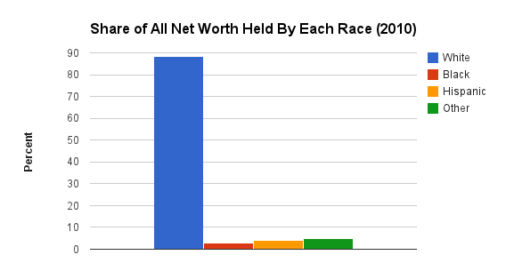
Structural Racism
Policies
Practices
Cultural Messages (convey beliefs)
Racially Inequitable Outcomes
Lead to:

Slide 8
Cultural Messages (convey beliefs)
Practices
Policies
Structural Racism
Beliefs Internalized, Lead to:
Individual Racism
,
Implicit Bias
(unintentional, subconscious)
Individual Racism
(beliefs)
Interpersonal Racism
(actions)

Slide 9
Systemic Racism
Cultural Messages (convey beliefs)
Practices
Policies
Structural Racism
Racially Inequitable Outcomes
Beliefs inform processes and actions, leading to
Beliefs Internalized, Lead to:
Individual Racism
,
Implicit Bias
(unintentional, subconscious)
Individual Racism
(beliefs)
Interpersonal Racism
(actions)

Slide 10
What is Racial Equity?
Racial equity means:
“Closing the gaps so that race does not predict one’s success, while also improving outcomes for all
To do so, have to:
Target strategies to focus improvements for those worse off
Move beyond “services” and focus on changing policies, institutions and structures and increasing decision making power for those most affected
Definition adapted from CSI: Center for Social Inclusion

Slide 11
Racial Equity is an outcome and a process
We look at the outcomes—like closing the gap on leadership, wealth, educational attainment, and health to judge whether there is racial equity
We also look at the process: Are those most affected leading and shaping the process?

Slide 12
Racial Equity vs. Discrimination
Racial equity focuses on the outcomes and processes to get there
Discrimination focuses on the action and the intent behind a decision or act, not the outcome

Slide 13
How can we undo racism?
Awareness
Change--Consider the racial implications when making a decision: Choice Points

Slide 14
What are Choice Points?
Decision-making opportunities to influence outcomes
Even a series of small changes can lead to significant impacts
Creating a practice of looking for opportunities to make change will lead to cumulative change

Slide 15
Assessing Choice Points to Reduce Structural Racism
Consider the Potential Impact
(make adjustments to try to eliminate racialized harm)
Assess the impact
If it there is not racialized harm, institutional racism is not active
If there is racialized harm, institutional racism is ACTIVE, and the decision should be modified to reduce the harm (start over)

Slide 16
Looking through the Lens: Questions We Use
Who pays?
Who benefits?
Who decides?
Who is missing?

Slide 18
What are the outcomes?
Are they different for people of different races and ethnicities?
If so, why?

Slide 19
What’s the narrative?
What are the underlying beliefs and assumptions behind this decision, practice or message?

Slide 20
Where are the Choice Points?

Slide 22
Application: Flint Water Crisis
Who pays?
Who benefits?
Who decides?

Slide 23
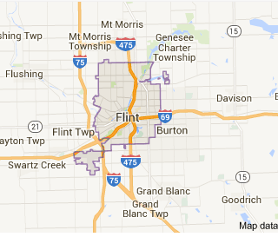
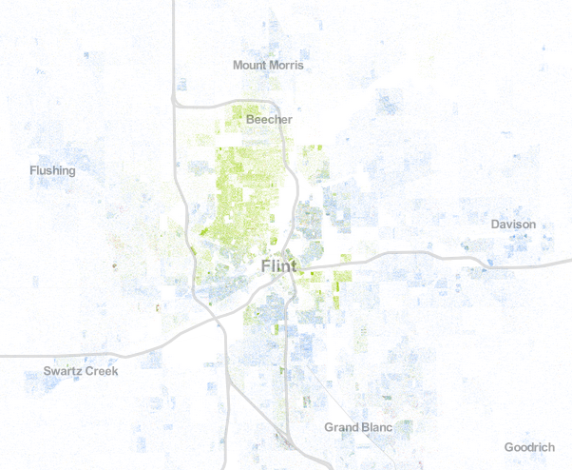
Why is this a racial equity issue?

Slide 24
Questions?

Slide 25
Sources and Resources
Our methodology is a collaborative concept that is still in development, and is being co-created with contributions that include the following sources:
DEAL Members and Staff
2014-15: http://law.wayne.edu/keithcenter/detroit-equity-action-lab/cohort-bios.php
2015-16: http://law.wayne.edu/keithcenter/detroit-equity-action-lab/cohort-bios-2015-16.php
Racial Equity Tools
http://www.racialequitytools.org/home
CSI: The Center for Social Inclusion
http://www.centerforsocialinclusion.org/
Race Forward
https://www.raceforward.org/
Especially: “An Introduction to Racial Equity Assessment Tools,” available at: http://grenetwork.org/wp/wp-content/uploads/2014/04/An-Introduction-to-Racial-Equity-Assessment-Tools.pdf

Slide 26
Thank you!

